Slide 1
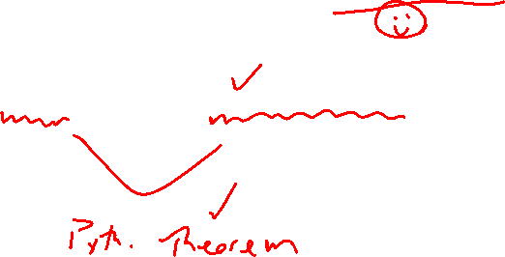
Section 1.2 Graphs of Equations in Two Variables; Circles
Lecture 2
Circles and the Distance Formula

Slide 2
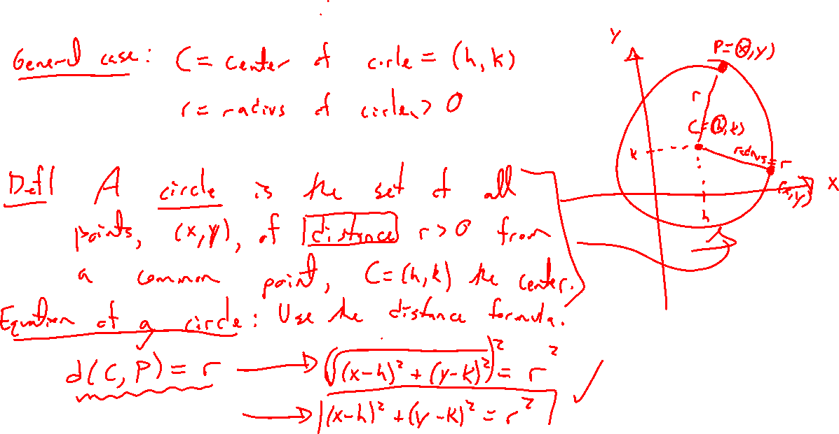
Circles: Generalizing the Distance Formula
Notes:
How to define a circle?
Given a point, find all points of distance r (radius) from that point.
Start with distance formula, rewrite without root and keep in mind radius need be positive.
Standard form, special case with center at the origin
Key is to see this as the distance formula

Slide 3
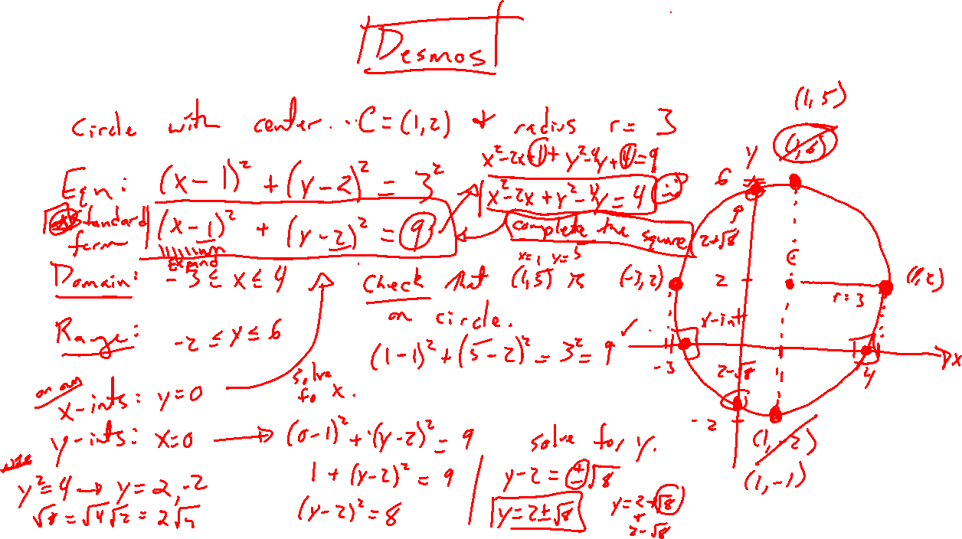
Example
Notes:
Graph circle with random center and radius.
Write equation and verify 4 easy points work.
How to find intercepts, maybe only x in this case?
Expand out to show non-standard form. How to go back? Complete the square.

Slide 4
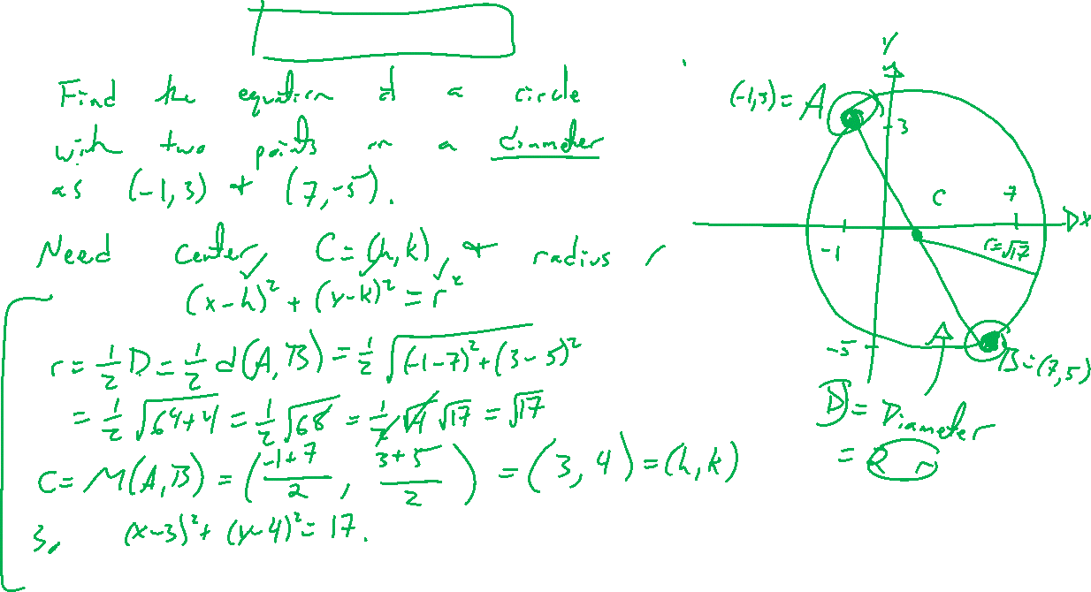
Example: Try on Own
Notes:
Find equation of circle with two points on a diameter as (-1,3), (7,-5)
Hint at steps, always need two things
Check equation in Desmos, tell to use Desmos in HW

Slide 5
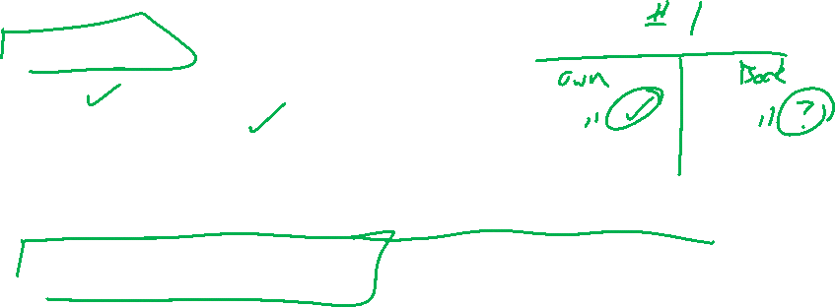
Section 1.2: Textbook Examples and Exercises
Rework examples 1, 3, 6, 8, 9 in the text. Steps:
Write down a problem.
Close the book and attempt on own.
Check / correct your solution against the text solution.
If needed, rewrite the problem to be of the quality of the text solution.
Complete exercises 13, 21, 51, 69, 75, 77
Write solutions of the same quality as in lecture and text solutions.
Check your solution against the answer in the back of the book.

Slide 6

Section 1.2 Homework Submission to Canvas
Preview of section
Skim the section in text and write a short paragraph summary.
Give a bulleted list of all important definitions, theorems, and formulas without details.
Notes on video lectures
Take notes on everything written on slides including all details, worked examples, on-own activities, as well as your own thoughts and questions.
Try on-own activities first, then write down provided solution next to it for comparison.
Worked examples from the text
Write down the problem and attempt without looking at the solution.
Use the solution to write the best explanation you can.
Solutions to textbook exercises
Model approaches and explanations given in the video lectures and textbook examples.
Final reflection of section
List the key takeaways to remember as a bulleted list.

